Slide 1

Stock Market Prediction using Daily News Data
Spandan Gupta
Data 606 Capstone Project

Slide 2
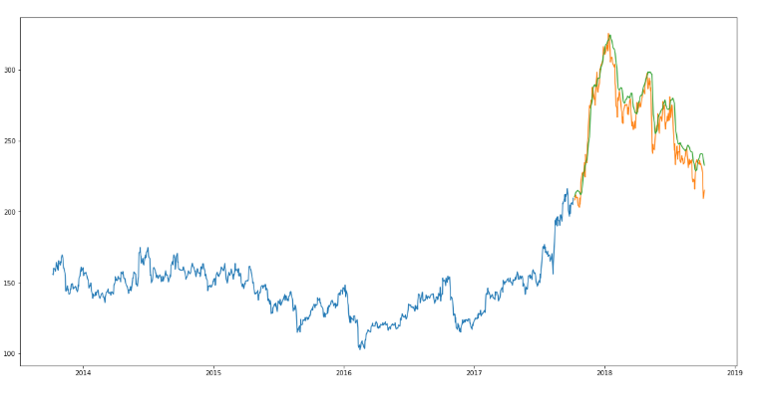
Related work
Aishwarya Singh, Predicting stock prices using LSTM, Analytics Vidhya, 2018
Yacoub Ahmed, Yibin Ng, Jere Xu on Toward Data Science have similarly implemented LSTM, linear regression and k-nearest neighbor.
Figure here shows the predicted closing prices

Slide 3
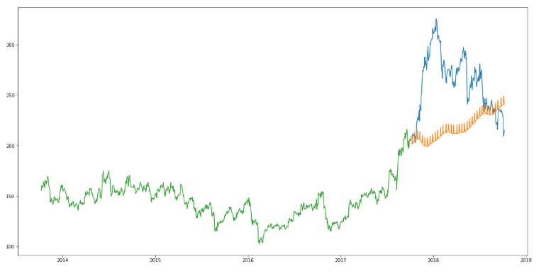
Related work
Aishwarya Singh, Predicting stock prices using Prophet by Facebook, a time series forecasting library, Analytics Vidhya, 2018
Figure here shows the prediction of the closing prices on Prophet

Slide 4
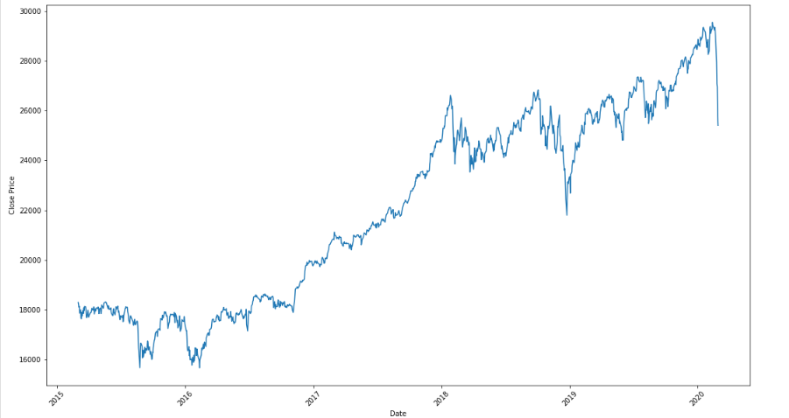
Closing stock prices varying over 2015-2020-EDA

Slide 5
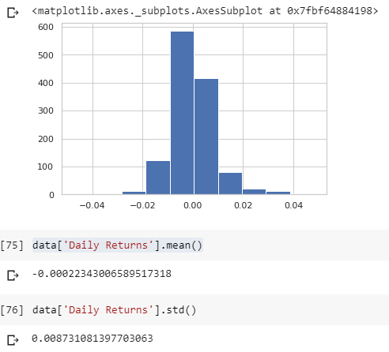
Daily returns estimation
Daily returns would not yield fruitful outputs
Longer duration investments are advisable generally due to this analysis
Figure here depicts the daily returns on stocks as a histogram

Slide 6
Any questions or suggestions?
Please contact Spandan Gupta
Email : spandangupta16@gmail.com
Github : https://github.com/spandangupta/Data606
Thank you!

